Slide 1
HTML Hyperlinks

Slide 2
Hyperlinks
The web pages in a website are linked with each other.
Clicking on a section of text or an image in one web page will open an entire web page or an image belonging to either the same web site or to another over the Internet.
The text or an image that provides such linkage is called Hyperlink, Hypertext or Hotspot.

Slide 3
Hyperlinks
A Hyperlink can be easily identified by following properties:
Hyperlink is normally underlined.
Color of Hyperlink is normally different form normal text (.i.e. it is blue.).
When mouse pointer moves to a hyperlink, arrow pointer changes to a pointing hand.
Any type of hyperlink can be created using <A> tag in a web page.
<A> is pair tag and text between <A>---</A> is displayed in the webpage as a link.

Slide 4
Types of Hyperlinks
Internal Document Reference:
The hyperlinks are linked with other locations within the same page.
The locations, to which these hyperlinks are linked, called Bookmarks.’
The Bookmarks helps the viewer to easily navigate/find a particular place in the same web page.

Slide 5
Types of Hyperlinks
Internal Links:
The hyperlinks are linked with the other web pages within the same website.
External Links:
These are the hyperlinks that are linked with web pages within the other website or with other websites.
Email Links:
These are the hyperlinks that are linked with the E-mail address of a person.
The E-mail application (MS-Exchange) starts automatically, when the user clicks on them.

Slide 6


Slide 7
Hyperlink Colors
By default hyperlink color is blue.
Blue color can be changed by using some attributes in the <BODY> tag. The value of these attributes can be either a color name or its hexadecimal value.
By default, links will appear as follows in all browsers:
An unvisited link is underlined and blue
A visited link is underlined and purple
An active link is underlined and red

Slide 8
Hyperlink Colors
Link : it sets the color for a hyperlink before it is clicked or visited.
ALINK : it defines the hyperlink color when mouse is in the clicked position over a hyperlink. It remains until the mouse button is pressed and disappears when the button is released.
VLINK : it sets the color for hyperlink after it has been visited.

Slide 9
Creating Hyperlinks in HTML
Tags used for creating hyperlinks is
<A HREF =“page.HTML”> Link Text </A>
Attributes
HREF : specifies the location to which the link is connected. An anchor can be linked to:
Another web page.
Another part of the same web page.
A file etc.
TARGET : specifies the window to open the linked page.
Its value “_blank” specifies that the linked page should be opened in a new web browser window.
The default is the same web browser window.

Slide 10
Links to Relative address Another Web Page in the Same Site
A hyperlink can refer to a web page in the same website.
This type of hyperlink is frequently used in almost all websites.
Examples:
<A HREF =“Contact.HTML”>Contact us.</A>
The text “Contact us” is a hyperlink that refers to Contact.HTML.
The file should be in the same directory.
<A HREF =“pages/Contact.HTML”>Contact us.</A>
The Contact.HTML is stored in directory “pages”, stored in the same directory in which the current page is stored.
<A HREF =“Contact.HTML” TARGET =“_blank”>Contact us.</A>
New page has to be opened in a new web browser window.

Slide 11
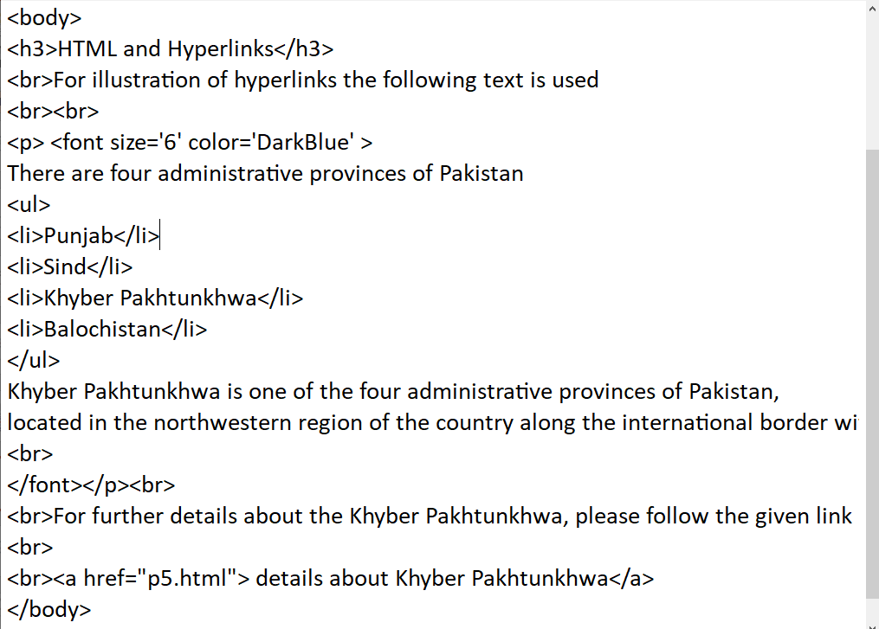

Slide 12
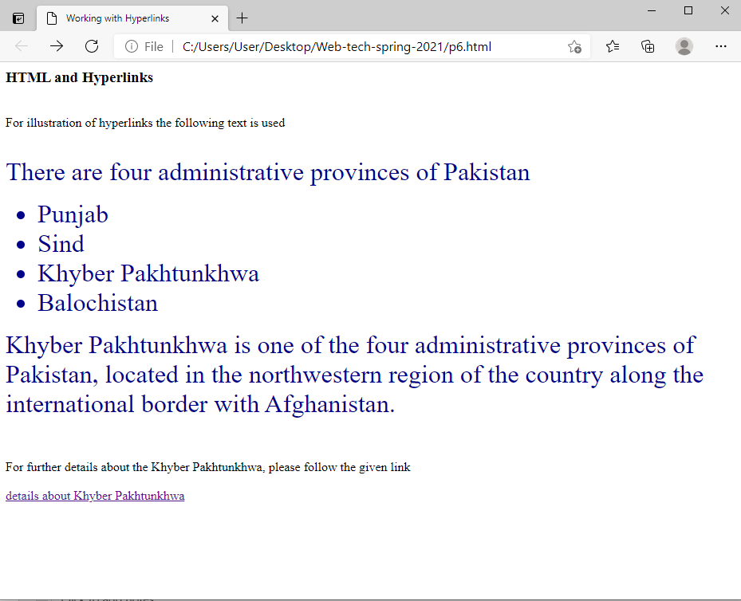

Slide 13
Links to absolute address the Pages of Other WebSites
A hyperlink can refer to a web page of another website.
A full web address should be mentioned in ‘href’ attribute
The visitor can move to that page by clicking that hyperlink.
Example.
<A HREF =“http://www.itseries.com/books.asp”>
Click here to view list of books. </A>
http:// must be used if the link refers to a web page of another website.

Slide 14
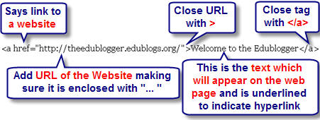

Slide 15
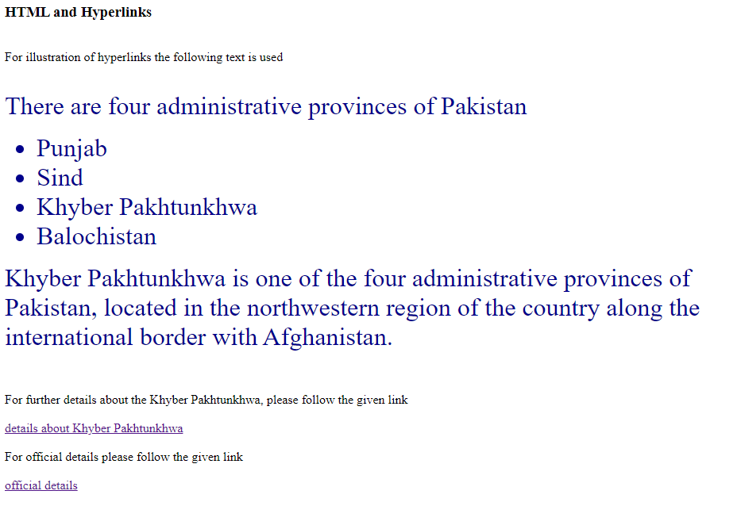
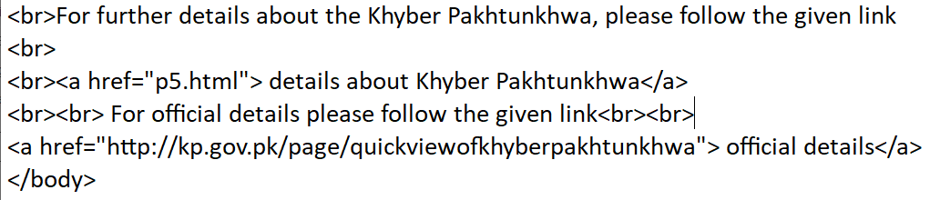

Slide 16
E-mail Hyperlinks
An E-mail hyperlink is a type of hyperlink that is linked to send E-mail to the specified E-mail address.
As the user clicks on the hyperlink, the default E-mail editor opens.
The mailto attribute is used in <A>tag to create E-mail hyperlink.
Example:
<A HREF =“mailto:abc@gmail.com”> Email</ A>

Slide 17
Links to Other Parts of the Same Page
A hyperlink can refer to another part of the same webpage.
This is done in two steps:
NAME attribute is used in <A> tag to identify the location that will be connected with the hyperlink.
Create the hyperlink.
Example:
<A NAME =“location”></A>
<A HREF = “#location”>Jump.</A>

Slide 18
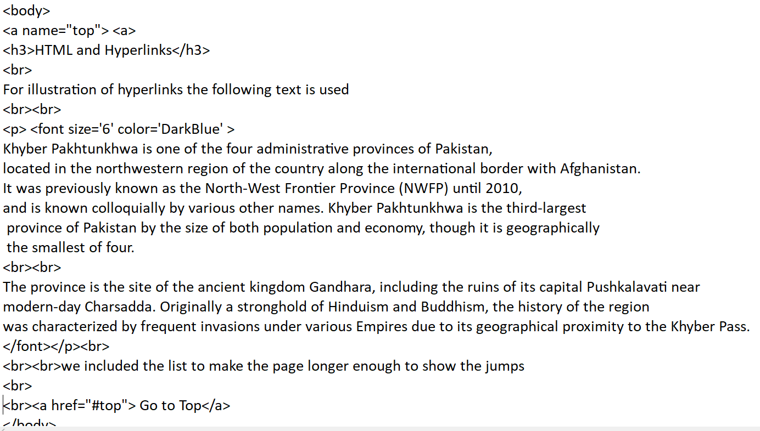

Slide 19
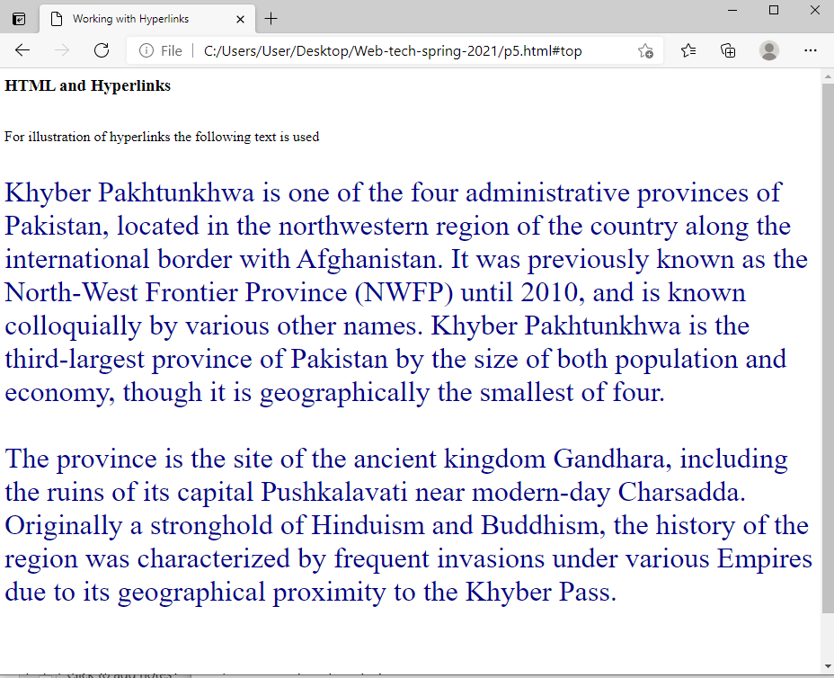
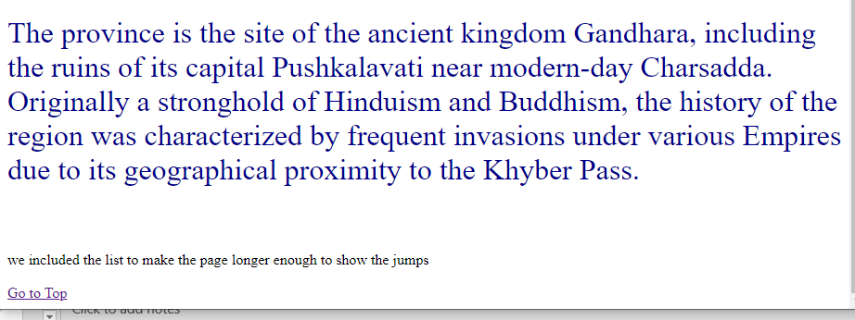

Slide 20
Setting Images as Hyperlinks
Images can also be used as hyperlinks.
The method of using images as hyperlinks is similar to text hyperlinks.
Example:
<A HREF =“http://www.yahoo.com” TARGET = “_blank”>
<IMG SRC=“flr.JPG”>
</A>
In this example abc.JPG will become a hyperlink.

Slide 21
Image Maps
Instead of making the entire image as hyperlink, there is a way to make hot spots within an image called image maps.
An image map is a way of defining “hot spots” links within an image on a web page.
Different parts of the image in an image map are linked to different locations.
Linked regions of an image map are called “hot regions” and each region is associated with filename.HTML, that will be loaded into the browser when the “hot region” is clicked.

Slide 22
The “USEMAP” Attribute
Image map is associated with an image by adding the “usemap” attribute to <IMG> tag.
<IMG SRC=“Symbols.GIF” WIDTH=“20%” HEIGHT=“20%” BORDER=“0”
USEMAP=“#symbols”>
• In the above line, USEMAP=“#symbols” associates the image map with the image.

Slide 23
<MAP> Tag
<MAP> tag defines the map for creating an image map.
It tells the browser where the hot spot exist in the image and also links the hot spots with different locations.
All elements of image map are defined inside <MAP> …</MAP> tags.
<MAP> tag requires NAME attribute
<MAP NAME = “picture”>
Hotspots designated with AREA element, defined inside <MAP> …</MAP> tags.
AREA attributes:
HREF: sets the target for the link on that spot.
SHAPE and COORDS set the characteristics of the AREA.
TITLE: provides tootltip, textual description.

Slide 24
<AREA> element (continued)
• SHAPE = “rect”
Causes rectangular hotspot to be drawn around the coordinates given in the COORDS attribute.
COORDS - pairs of numbers corresponding to the x and y axes:
x axis extends horizontally from upper-left corner.
y axis extends vertically from upper-left corner
A rectangle will take four coordinates X1, Y1, X2, Y2.
Ex. <AREA HREF = “form.html” SHAPE =“rect” COORDS = “3, 122, 73, 143” TITLE = “Go to the form”>
Rectangular hotspot with upper-left corner of rectangle at (3, 122) and lower-right corner at (73, 143).

Slide 25
<AREA> element (continued)
• SHAPE = “poly”
Causes a hotspot to be created around specified coordinates for a polygon.
A polygon will take three or more pairs (X1, Y1, X2, Y2,---, Xn, Yn) of coordinates denoting a polygonal region.
x axis extends horizontally from upper-left corner.
y axis extends vertically from upper-left corner
Ex. <AREA HREF = “http://www.yahoo.com” SHAPE = “poly” COORDS = “28, 22, 24, 68, 46, 114, 84, 111, 99, 56, 86, 13” TITLE = “Link to YAHOO!”>.

Slide 26
<AREA> element (continued)
SHAPE = “circle”
Creates a circular hotspot.
A circle will take three coordinates: centerX, centerY and radius in pixels.
CenterX axis extends horizontally from upperleft corner.
CenterY axis extends vertically from upper-left corner.
Radius specifies the radius of the circle.
Ex. <AREA HREF = “http://www.yahoo.com” SHAPE = “circle” COORDS = “146, 66, 42” TITLE = “Link to YAHOO!”>.

Slide 27
<AREA> element (continued)
• SHAPE = “default”
Represents the remaining area of the image not defined by any <AREA> element.
If NOHREF attribute is used with default or another <AREA> element, the hot spot will not link to any thing.

Slide 28
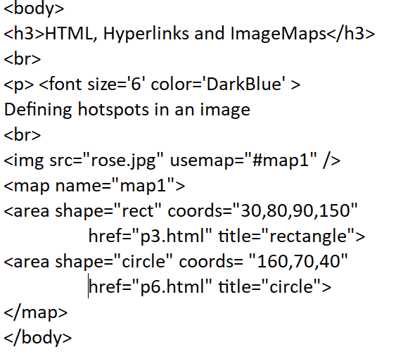
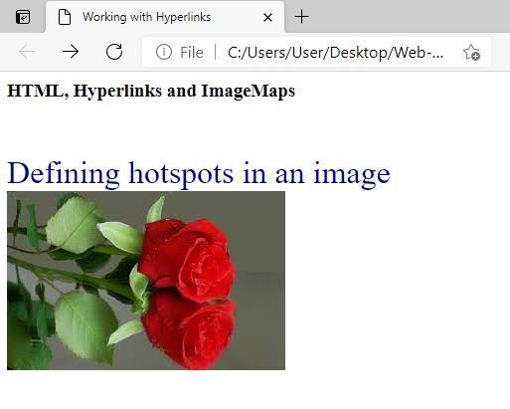
Example

